Slide 1
Course Pre-requisites
HTML
CSS
Bootstrap
OOPS (Object Oriented Programming)
JavaScript or any programming language knowledge (Java/C#/C++,Python)
Self Study Tutorials
HTML/CSS/Javascript/Bootstrap: www.w3schools.com
OOPS Concepts: https://www.edureka.co/blog/object-oriented-programming/
Programming Basics: https://www.edureka.co/blog/cpp-tutorial/

Slide 2
Course Material Link
Kindly download from one drive to your local systems
Google Drive Link: https://bit.ly/eduangular
Content is also available on your edureka website LMS dashboard

Slide 3
Enterprise Applications
Server
Desktop
Desktop
Server
Desktop
Middleware
Server
Web Client
Middleware
Server
Data Services
Mobility Client
Middleware
Server
Data Services
Wearable's
Cloud

Slide 4


#Digital

Slide 5
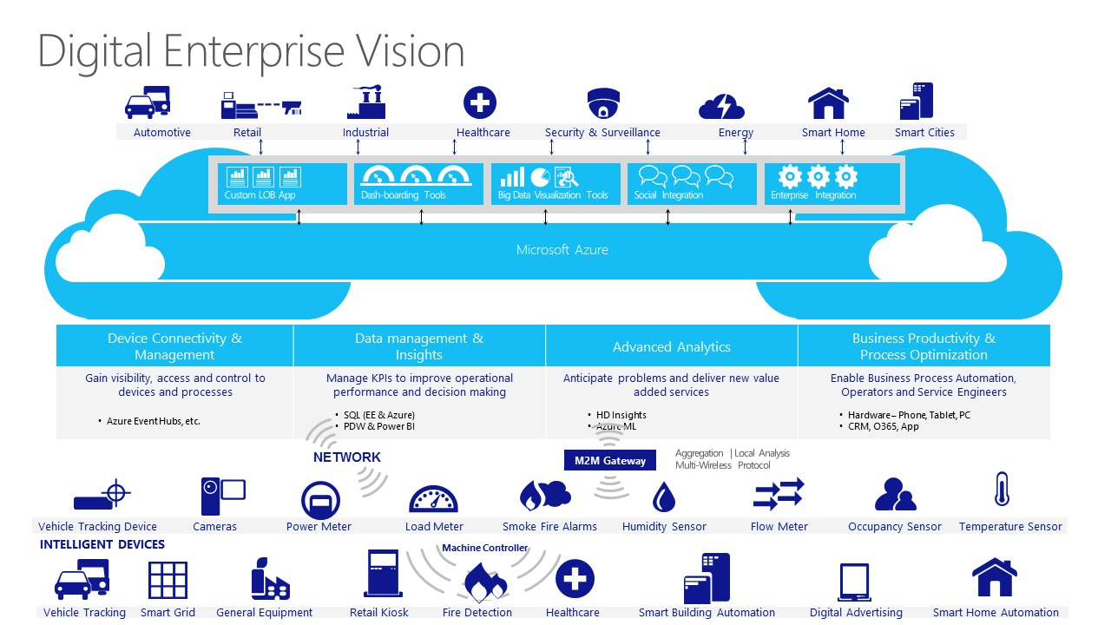

Slide 6
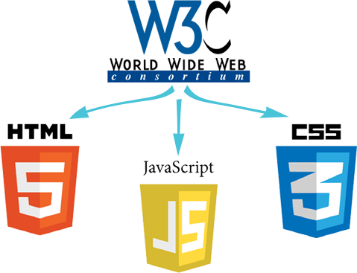
Standards

Slide 7
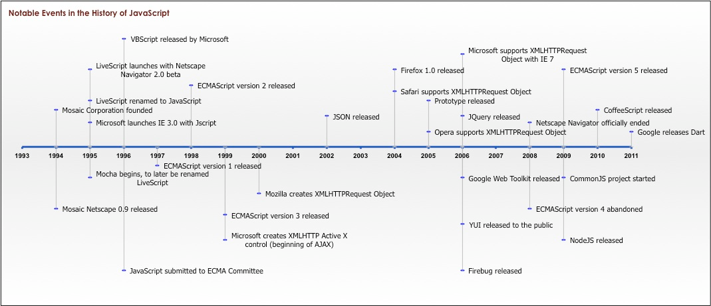
JavaScript!

Slide 8
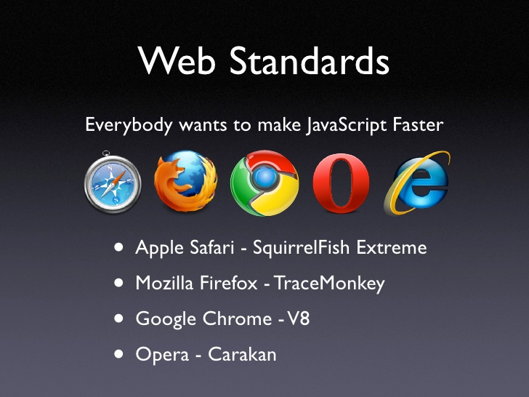
Speed

Slide 9
Client
Web Server
Request
HTML
CSS
JavaScript
IIS
WebLogic
Web Sphere
JBoss
Apache
Tomcat
Response

Slide 10
Client
Web Server
Request
HTML,CSS,IMG,DATA,JS
HTML,CSS,IMG,DATA,JS
HTML
CSS
JavaScript
IIS
WebLogic
Web Sphere
JBoss
Apache
Tomcat
Response

Slide 11
Client
Web Server
DATA
Request
HTML,CSS,IMG,DATA,JS
HTML
CSS
JavaScript
IIS
WebLogic
Web Sphere
JBoss
Apache
Tomcat
Response

Slide 12
MEAN = MongoDB, Express, Angular , NodeJS
Client
Web Server
Angular
Code is flexible to change & maintainable based on MVC principle
Segregation od Concern into components. Build into JS
Npm Modules
ExpressJS
NodeJS
TypeScript
NODEJS:
Development environment
ExpressJS:
Configures NodeJS as a Web
Server for Deployment
Npm Modules
API to build SPA Apps
ECMA Script Standard, created by Microsoft
Supports OOPS keywords, eg. Class, extends etc..
Provides compile time errors , Compiles into JS
BootStrap
Created by Twitter . Open Source. Scaled UI to diff. screen sizes
Supports Responsive Web Design
JQuery
Open Source Library, reduces no. of lines of code
Higher probability of code executing on diff. browsers
Emits JavaScript into the browser
JavaScript
ECMA standard for calling DOM API
Client browser only has JS runtime engine
DOM
W3C API for dynamically modifying the HTML on client side
Parser to convert HTML to tree structure for quick HTML element searches and modification
CSS 3
W3C standard for styling the UI
Mobile Friendly
HTML 5
W3C standard for creating page structure / UI
Mobile Friendly

Slide 13
Course Pre-Requisites
To Learn visit: www.w3schools.org
BootStrap
Created by Twitter . Open Source. Scaled UI to diff. screen sizes
Supports Responsive Web Design
JQuery
Open Source Library, reduces no. of lines of code
Higher probability of code executing on diff. browsers
Emits JavaScript into the browser
JavaScript
ECMA standard for calling DOM API
Client browser only has JS runtime engine
DOM
W3C API for dynamically modifying the HTML on client side
Parser to convert HTML to tree structure for quick HTML element searches and modification
CSS 3
W3C standard for styling the UI
Mobile Friendly
HTML 5
W3C standard for creating page structure / UI
Mobile Friendly

Slide 14
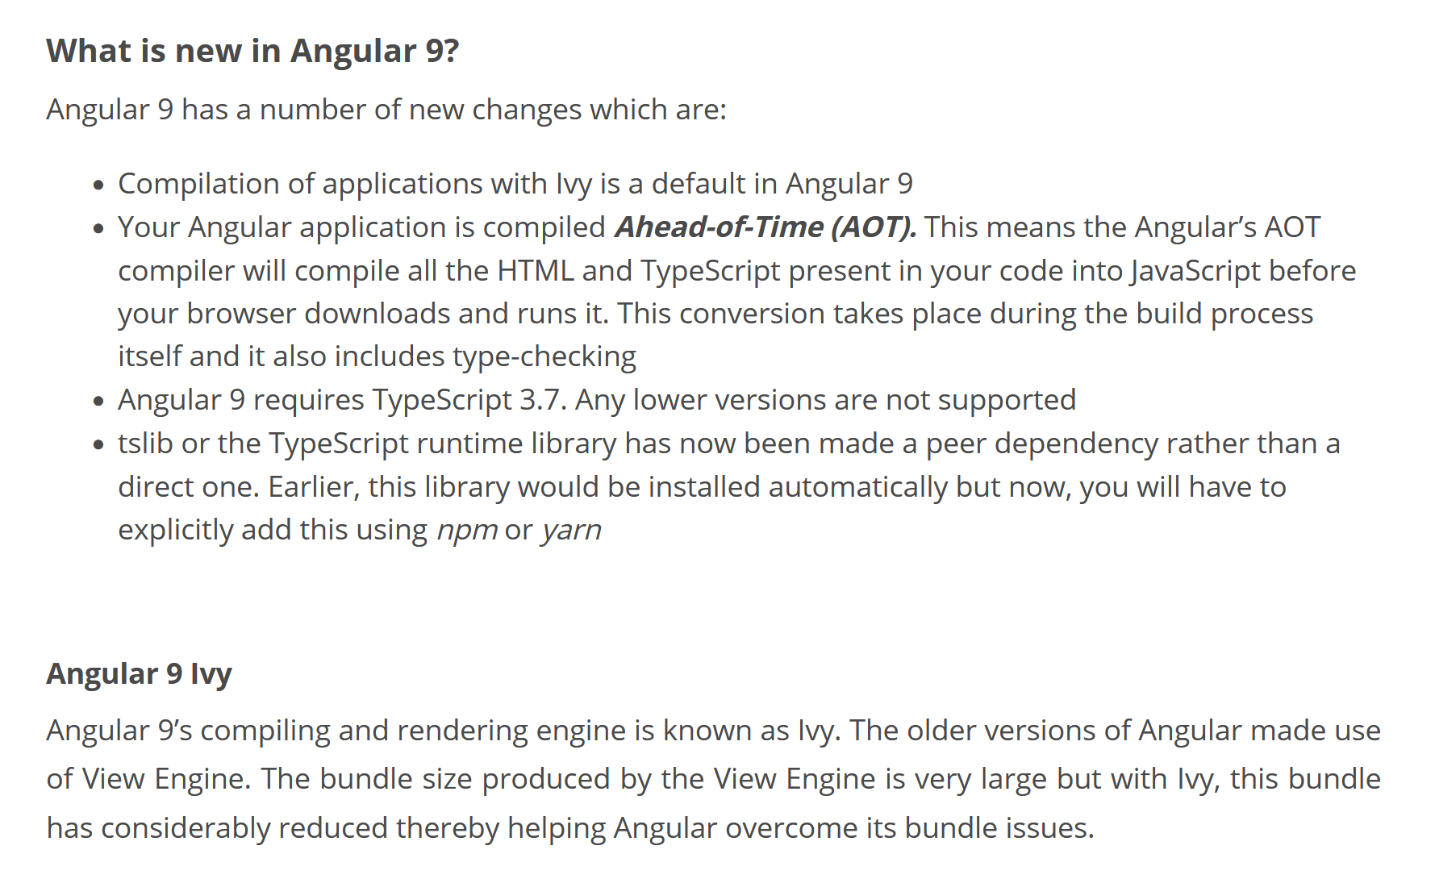

Slide 15
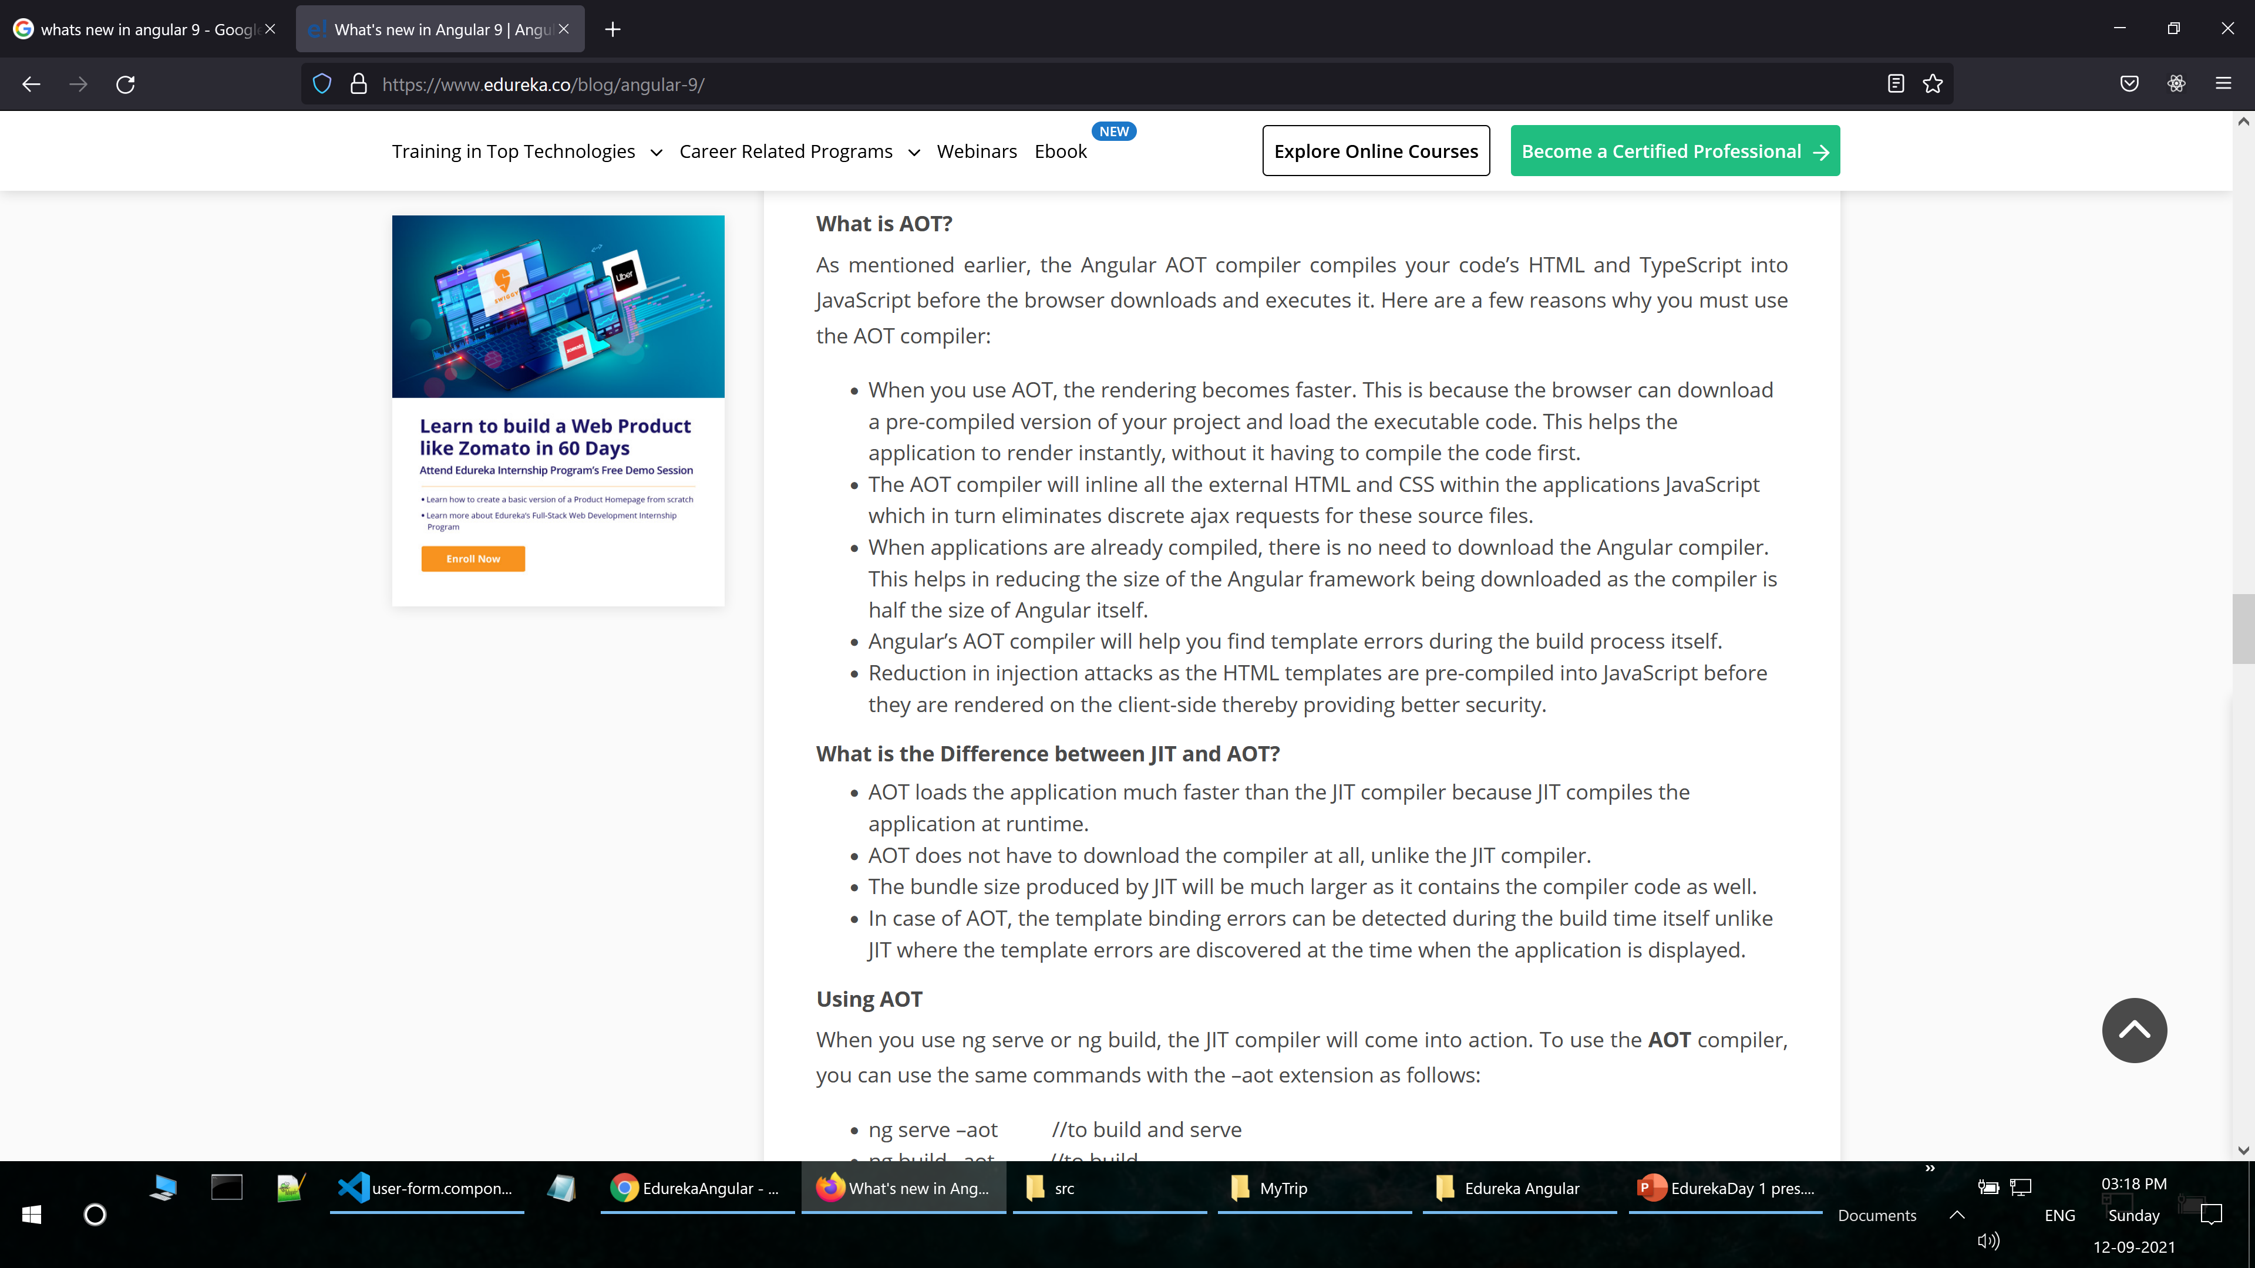

Slide 16
Traditional Dependency
Tightly Coupled Design : Not flexible to change
Customer
SavingAccount obj = new SavingsAccount();
CurrentAccount
SavingsAccount
SmartMoneyAccount

Slide 17

Dependency Injection
Loosely Coupled Design : Flexible to change
Account
Customer
Constructor(private obj: Account)
CurrentAccount
$$DI$$
$$Container$$
SavingsAccount
SmartMoneyAccount

Slide 18
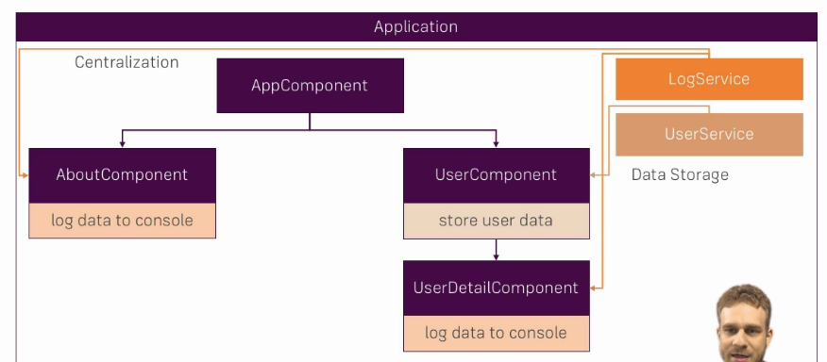
Services
Centralize code for reuse

Slide 19
Angular
TypeScript
X: number;
Directives
DataBinding
MVC
Struct/Atrr/Custom
Event / EventEmitter/ emit()
Components
DI
Rxjs/ Subject/ next() / subscs()/usubc()
Custom Comp.
Services
Observable
HttpClient / REST
Routing
Template Forms
Reactive Forms
Validators
Custom Validators

Slide 20
Client
Native App
Apache Cordova + Eclipse + SDK (Android)
KONY
Iconic
Angular
TypeScript
JQuery
Web Server
Hybrid
JavaScript
Git
Docker
Ngnix
ExpressJS
Node JS
DOM
Bootstrap
CSS 3
HTML 5
MEAN = MongoDB, ExpreeJS, Angular , NodeJS

Slide 21
Angular Route Guard
Services
Services
Components
Auth Service
Login /Logout
Servers
json data array
Auth Guard Service
Grants access to urls based on Login status
Server
Displays a server for every record in the json array
Edit Server
Edits Server records in the json array
Can Deactivate Guard Service
Grants access to urls based on Login status
Home
Displays a menu that displays the Servers components
Servers Service
Updates Servers Data
App Routing
Defines the routes
Server Resolver Service
Returns a server record, based on the id passed

Slide 22
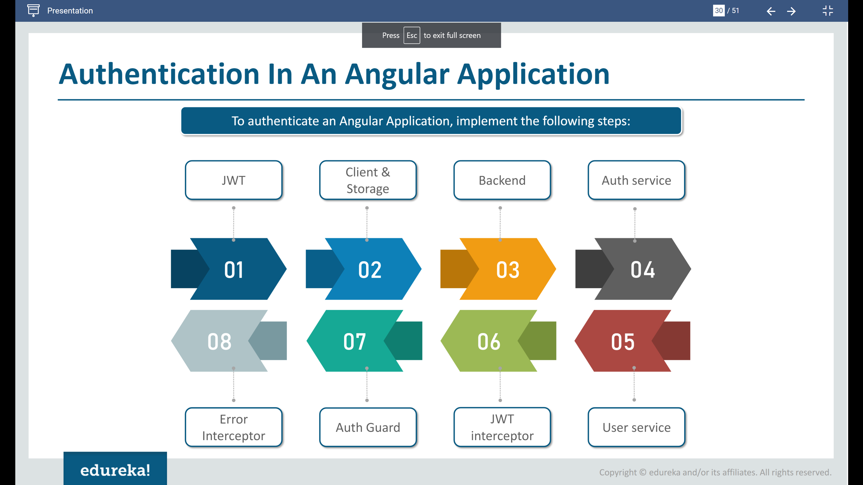

Slide 23
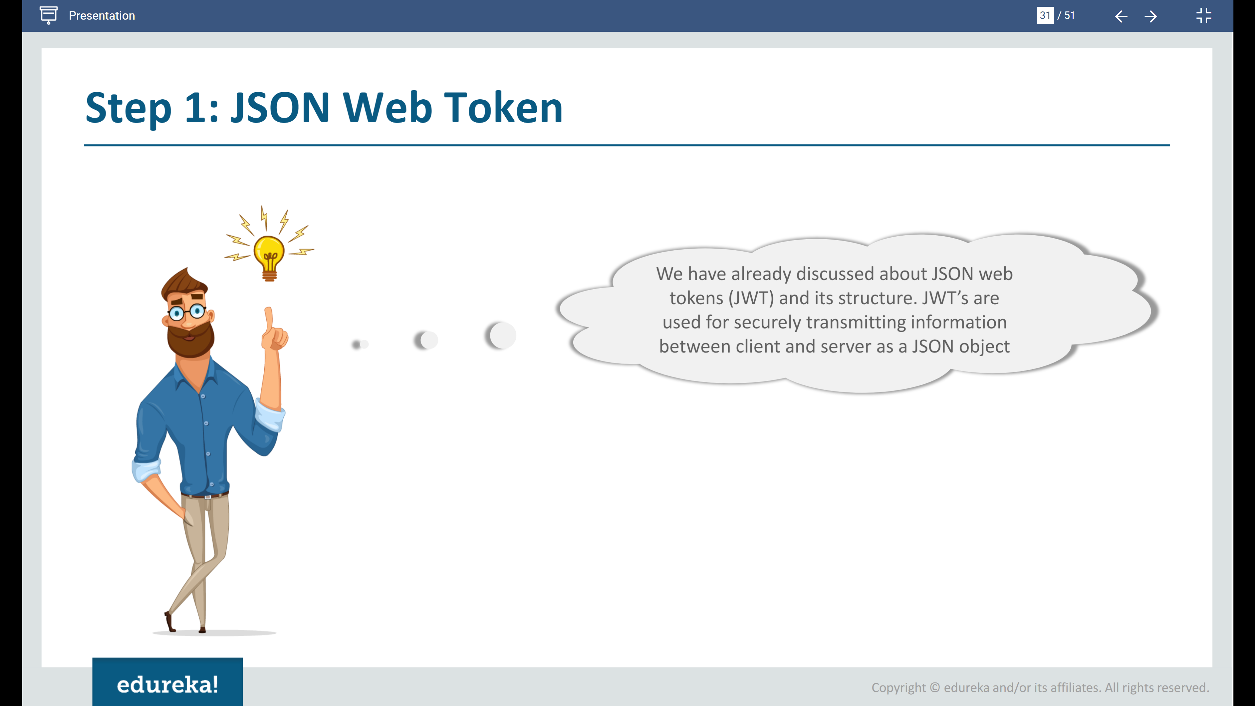

Slide 24
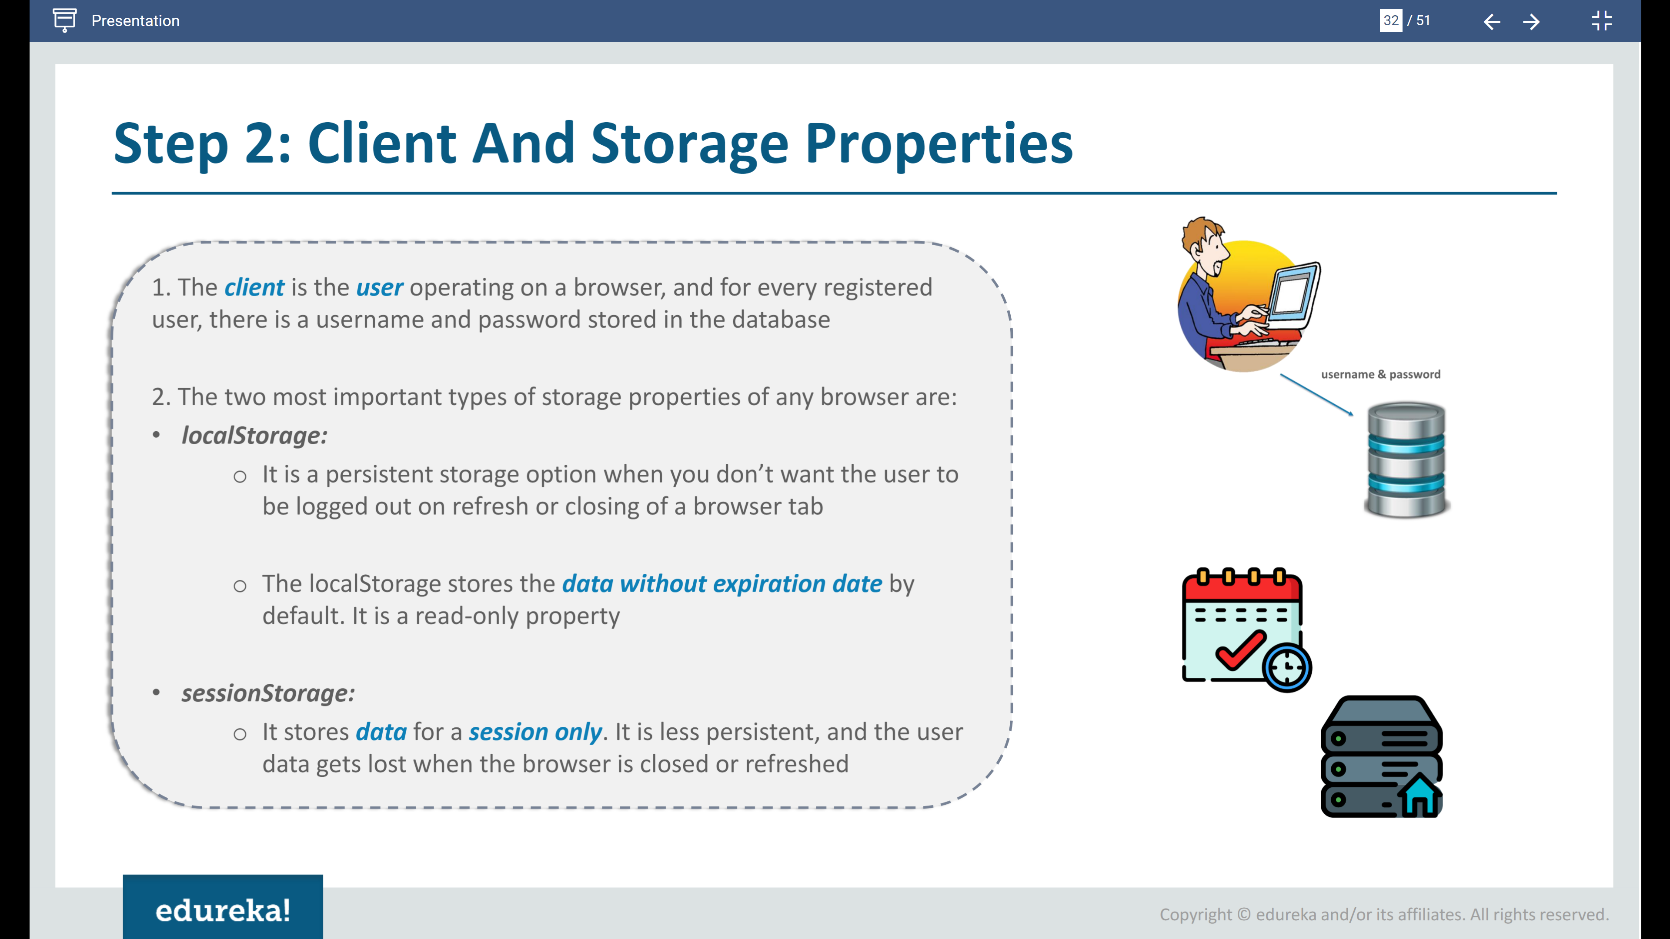

Slide 25
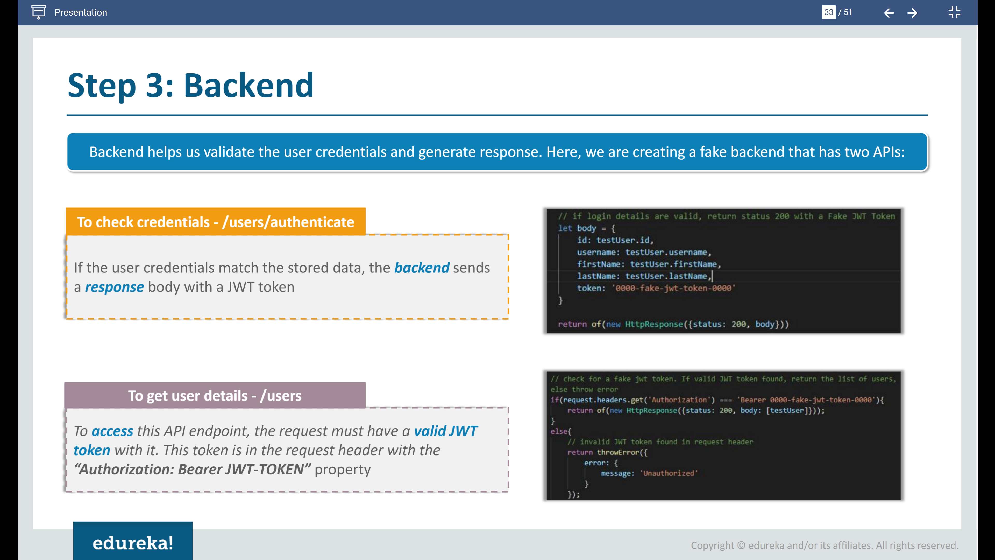

Slide 26
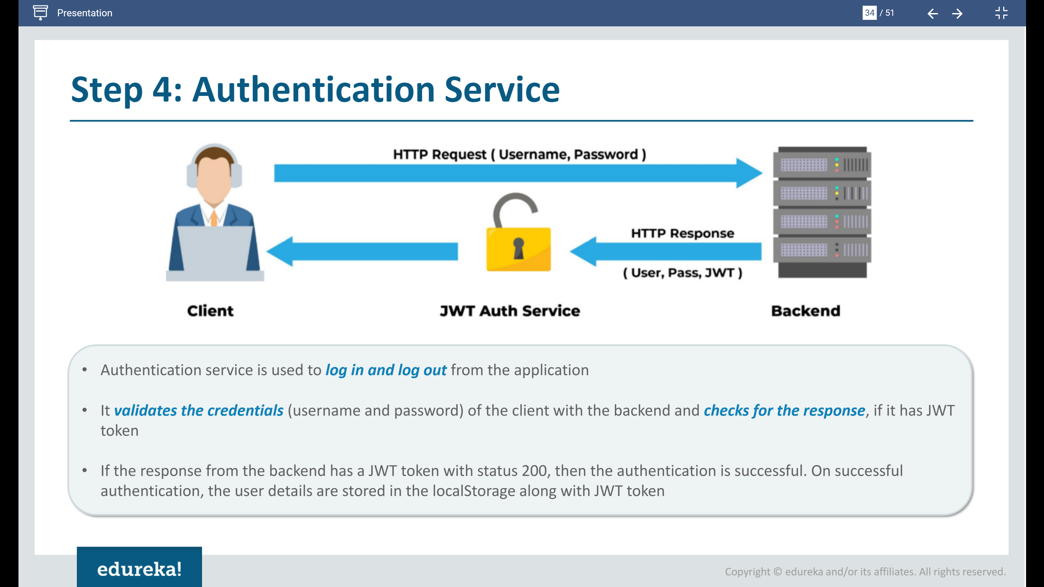

Slide 27
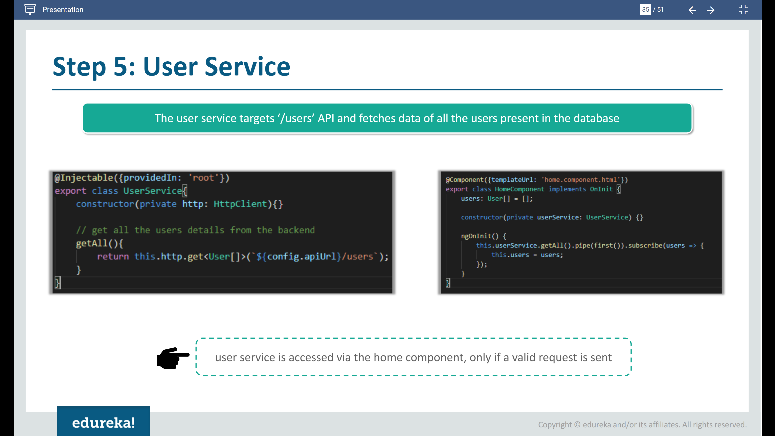

Slide 28
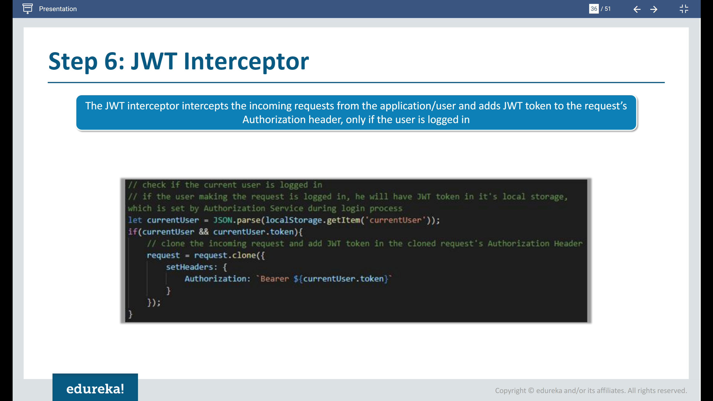

Slide 29
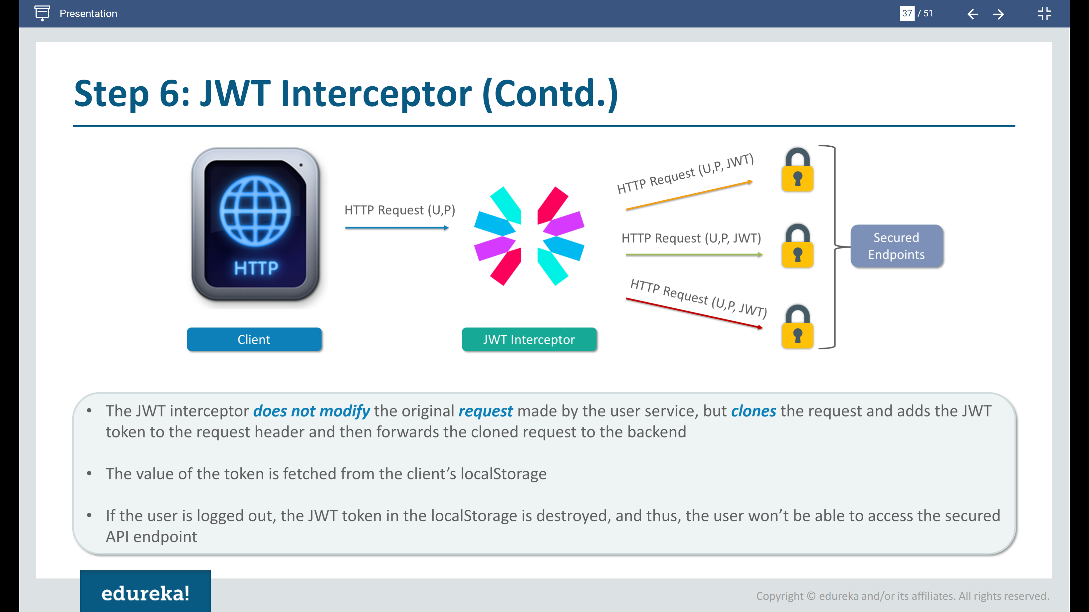

Slide 30
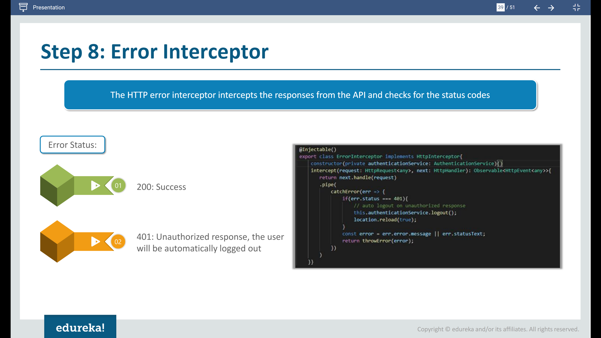

Slide 31
Angular - JWT
Fake Backend Service
Simulated REST API for registering (CRUD) / authenticating users from localstorage
Adds a JWT Token to a new user record
Verifies if users have interceptor “Bearer” keyword assigned
Defines REST API to register/delete users
User
Defined User Model Schema
Login/Register View
UI
Environment.ts
Port definition
Alert Service
Generates success/error msg
Authentication Service
On Login , sets current user in localStorage
On Logout , removes current user from localStorage
User Service
Manages user info.
Calls REST API to get/register/delete users
Alert View
Displays error msg
JWT Interceptor Service
Intercepts HTTP request
Prefixes JWT token in the user record, with “Bearer” keyword indicating valid user
Auth Guard Service
Route Guard definition decides which urls the user logged in can access
Error Interceptor Service
Manages HTTP Errors

Slide 32
Angular - JWT
Services
Auth Guard
Route Guard
Error Interceptor
Manages HTTP Errors
Fake Backend
Simulated REST API for registering / authenticating users & ads JWT Token
User
Defined User Model Schema
JWT Interceptor
Prefixes JWT token with “Bearer” keyword indicating login
Alert
Displays success/error msg
Authentication
Store users info in local storage
Users
Manages user info

Slide 33
